Slide 1
Final Coffee Sales Analysis
A Data-Driven Look at Sales Trends and Forecasting
- Vaibhav Borkar

Slide 2
Project Overview
1133 sales transactions analyzed.
Time range: March 1 – July 31, 2024.
Data included: products, prices, dates, payment methods, customer IDs.
Focus Areas
  Sales trends by time (hour/day/month)
  Best-selling products & revenue drivers
  Customer segmentation by frequency
  7-day sales forecasting using ARIMA

Slide 3
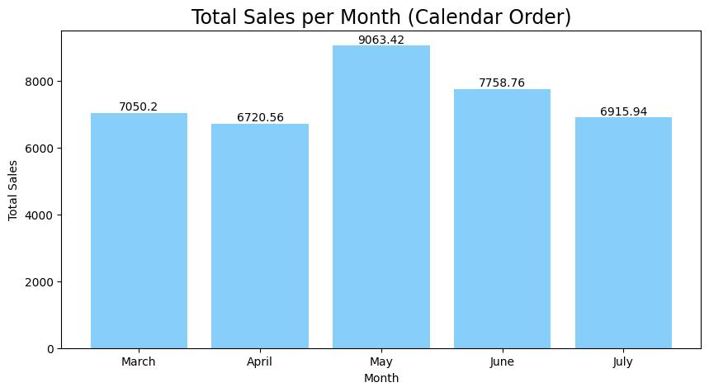
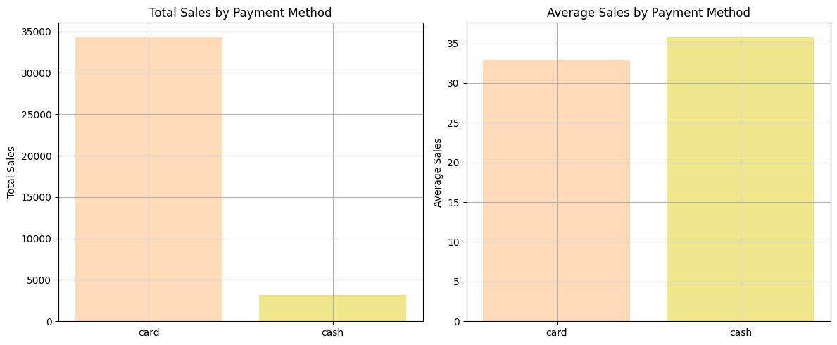
Sales Overview
Total Sales: $9,062.32
Card Payments: $34,322.88 — 91% of total sales
Avg. Transaction: $32.88
Cash Payments: $3,186.00 — 9% of total sales
Avg. Transaction: $35.40
Insight:
Card is the dominant payment method.
Cash users spend slightly more per transaction.

Slide 4
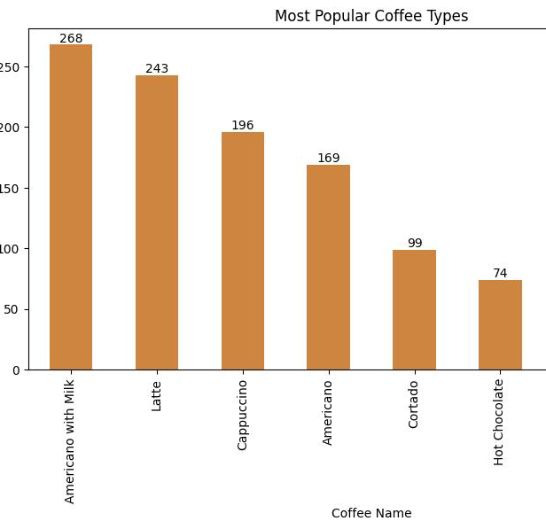
Top Products
By Revenue & Volume
  Latte: Highest revenue generator
  Americano with Milk: Most purchased item (268 units sold)
  Espresso: Strong, consistent seller
Recommendation:
Focus promotions and marketing efforts on these top 3 products to maximize sales and customer engagement.

Slide 5
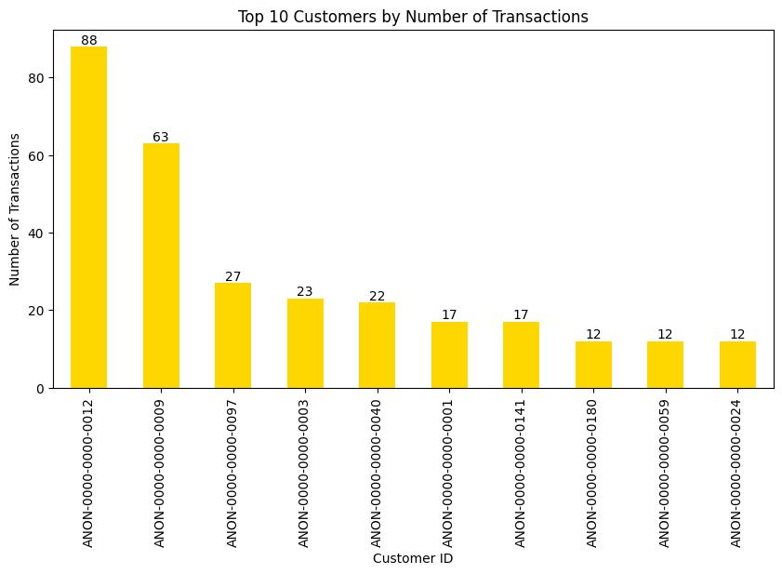
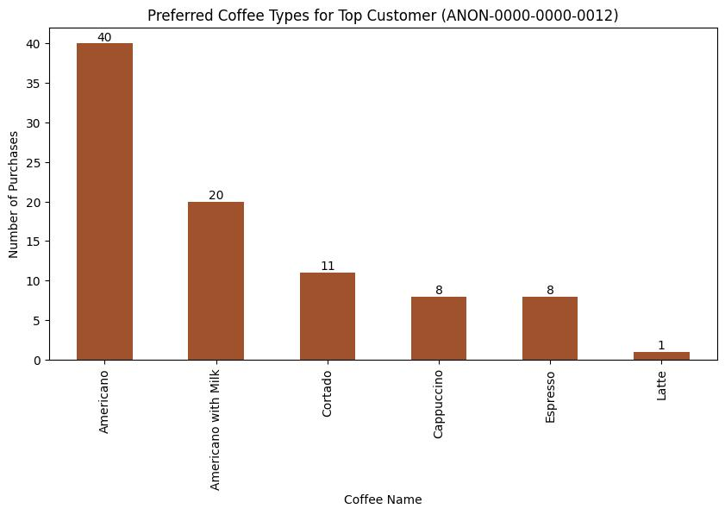
Customer Behavior
Top Customer: ANON-0000-0000-0012 with 88 purchases
Mostly drinks Americano
Spending & Frequency: Strong positive correlation — frequent buyers spend more
Recency Impact: Minimal effect on overall sales

Slide 6
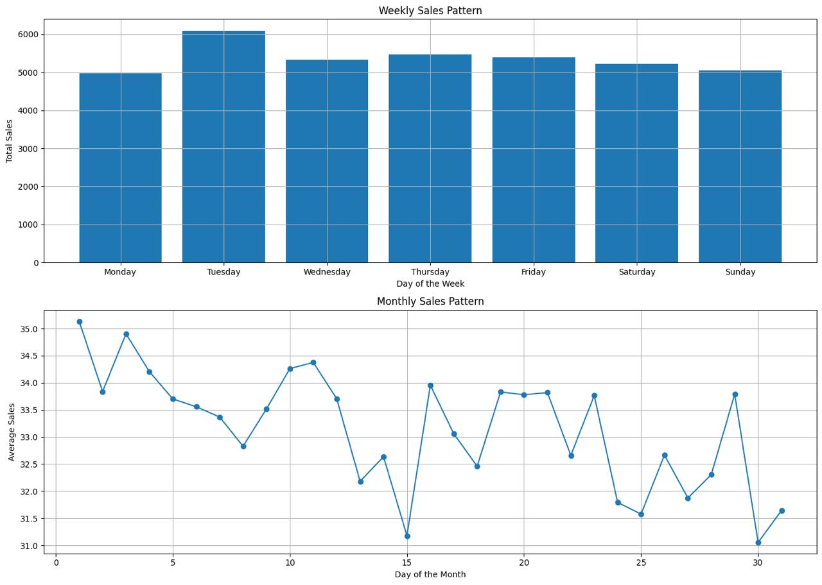
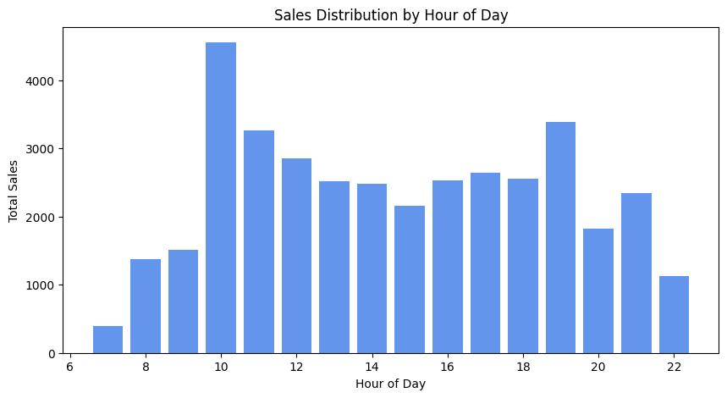
Sales by Time
Peak Hours: 10 AM – 2 PM
Best Day: Tuesday
Top Month: May 2024 ($9,063.42)
Recommendation: Target peak hours and weekends for promotions and ads

Slide 7
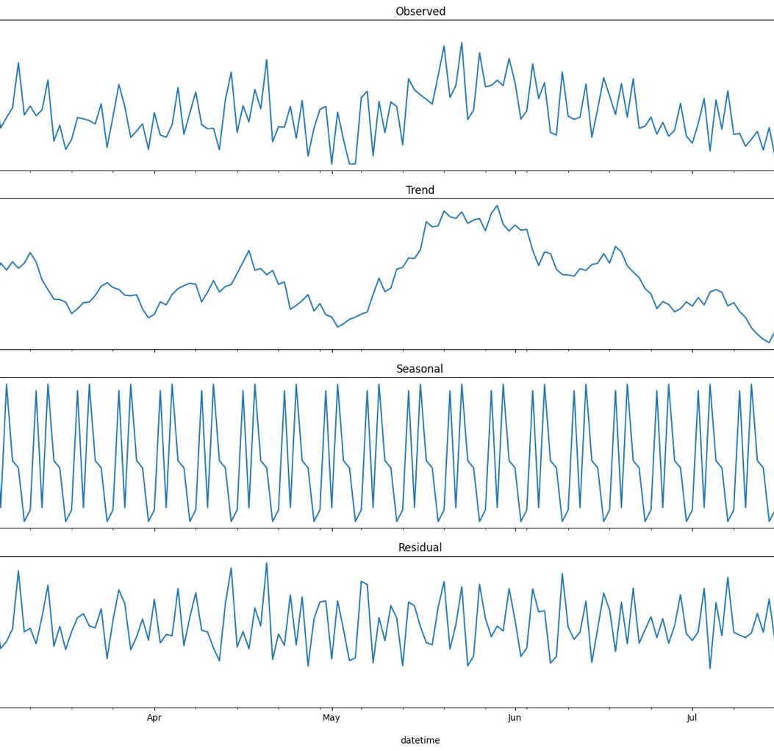
Seasonality & Trends
Weekly Peaks: Fridays & Saturdays show highest sales spikes
Monthly Pattern: Mid-month sales peaks consistently observed
Trend: Steady upward growth over the period

Slide 8
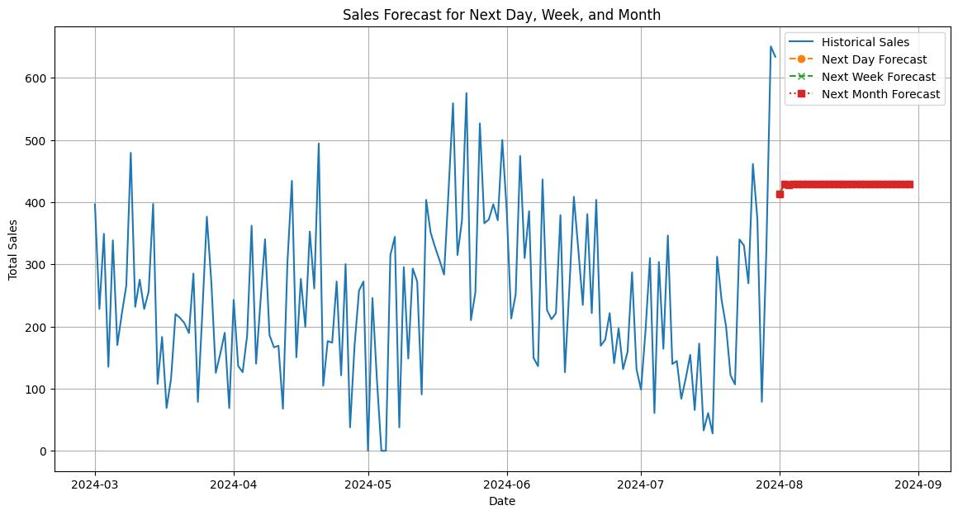
Sales Forecasting
Model Used: ARIMA (1,1,1)
7-Day Forecast: Approximately $428 per day
Outlook: Stable sales expected with no significant dips

Slide 9
Strategic Opportunities
Launch a Loyalty Program targeting card payment users
Promote Top-Selling Products during peak hours
Run Weekend Campaigns to capitalize on increased traffic
Implement Mid-Month Promotions to boost revenue

Slide 10
Next Steps
Deploy promotions based on time and product insights
Monitor top customer segments for personalization
Reassess forecast monthly
Use insights for pricing, staffing, and marketing decisions

